Slide 1
NYC’s Civic Innovation Fellowship
A program of
Manhattan Borough President Gale A. Brewer
& BetaNYC.

Slide 2
CIF Bootcamp
Demo Day

Slide 3


Today’s Agenda
Introductions from Will & Noel
Seasonal Analysis from Bruna Jermann
Effects of Superstorm Sandy by
Xiaolong Li
227 West 109th Street by Shalom Joseph
Street Conditions & Potholes by
Thierno Bah
Noise complaints from Tammoya More
Questions and Answers

Slide 4
Community Boards
About Community Boards:
12 community boards in Manhattan and 59 throughout the City.
Each consists of up to 50 volunteer members. Board members are selected and appointed by the Borough Presidents and must reside, work, or have some other significant interest in the community.
Each community board is led by a District Manager and implements procedures to improve the delivery of City services to the district.
Community Board Responsibilities:
Land Use and Zoning Matters - Changes in zoning must come before the Board for review.
City Budget - Assessing the needs of their own neighborhoods and make City budget recommendations to City agencies.
Community Concerns - Addressing any issue that affects part or all of a community, from a traffic problem to deteriorating housing.
Additional services - Many boards choose to provide additional services and manage special projects that cater to specific community needs, including organizing tenants associations, & coordinating neighborhood cleanup programs.

Slide 5

Last year’s intervention
"The wealth of city data available online needs to be made usable..."
Once the students are trained, they will work with Manhattan's community boards in solving neighborhood problems…
[This] initiative [is] a great way for the students involved to gain a foothold in what is an emerging industry.
"...these service corps members will have the tools for a new career in civic technology..."
Quotes from Hon. Gale A. Brewer
Source: Gotham Gazette, 15 Sep 2014, http://bit.ly/1IICEpR
Manhattan Borough President Gale A. Brewer & 2014’s CUNY Service Interns
Source: http://bit.ly/1JKdoR2

Slide 6
New intervention & goal

Slide 7
Increase quality public engagement with Community Boards & their offices.

Slide 8
Fellowship Timeline
Phase 1.1 Research * Discovery Workshops * Curriculum Development * Fellowship Recruitment | Phase 1.2 Fellowship * Fellowship bootcamp * Fieldwork & research * Program Showcase | Phase 1.3 Debrief * Feedback & review workshops * Continuing edu. for Community Boards * Develop insights for yr 2.
3 Months | 6 Months | 3 Months

Slide 9
NYC Civic Innovation Fellowship Toolkit
Tools
GitHub
Socrata
CartoDB
CKAN
Slack
Discourse
OpenRefine
Google Docs
Microsoft Excel
Practices
Project Management
Agile / Scrum
User Research
Journaling
Inclusive Development
Public Speaking
Map making
Data scraping
Data (examples)
NYC 311
City Record
Health Inspections
Public Safety
Business
US Census
Languages
HTML
Markdown
SQL

Slide 10
This year’s objectives
Develop Community Boards’
digital literacy.
Increase usage & quality of
NYC’s open data.
Improve Community Boards’ internal operations & data decision-making capabilities.

Slide 11
Bruna Jermann
Seasonal Analysis &
Broken Muni Meter

Slide 12
Outlining Assumptions
Winter: Heating and Hot Water
Spring: Noise
Summer: Noise
Fall: Taxi Complaints
Notes:
I made simple assumptions about the effect of seasons over complaint types. I thought: ...

Slide 13
Complaint Types by Season (2012 – 2015)
Source: Socrata, October 2015
Notes:
I made this graph too which is another way of comparing the complaint types. It’s nice cause you can see it as a general progression over the year
*Taxi Complaints go up on warmer months
* Noise is much higher on Spring
Fire safety stays almost the same
Heating only comes up on Winter and Illegal parking comes up in all seasons but Winter
It’s another way of looking at the same data

Slide 14
Seasonal Analysis
Total Winter | 22,647
Total Spring | 27,866
Total Summer | 27,094
Total Fall | 23,234
Total Complaints 2012 - 2015 | 100,841
Complaint Type | Complaints 2012 - 2015 | Percentage
Broken Meter | 11,340 | 11%
Taxi Complaint | 10,035 | 10%
Noise Complaint | 8,037 | 8%
Source: Socrata, October 2015
Notes:
There was a total of 100,841 complaints from 2012 to 2015, taking into account all complaint types (not just top 10)
The seasons with the highest average complaints are Spring and Summer.

Slide 15
Source: Socrata, October 2015
Notes:
I made a graph showing complaints through the years to check my assumption, and indeed there was a big drop!
Something big must have happened – perhaps they were fixed? More research would be needed to say for sure

Slide 16
Frequency
Source: Socrata, October 2015
Notes:
Here I compared different descriptors among broken meter complaints. No receipt wins by far… then in 2014, then go down by a lot. In 2015 ‘no receipt’ is no longer the highest complaint descriptor

Slide 17
Xiaolong Li
Superstorm Sandy &
Heat / Hot Water complaints

Slide 19
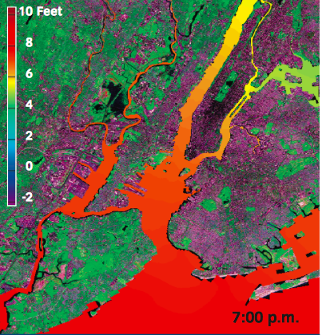
Sandy and Its Impacts
…More than 400 New York City Housing Authority buildings containing approximately 35,000 housing units lost power, heat, or hot water during Sandy…
http://www.nyc.gov/html/sirr/downloads/pdf/final_report/Ch_1_SandyImpacts_FINAL_singles.pdf

Slide 21
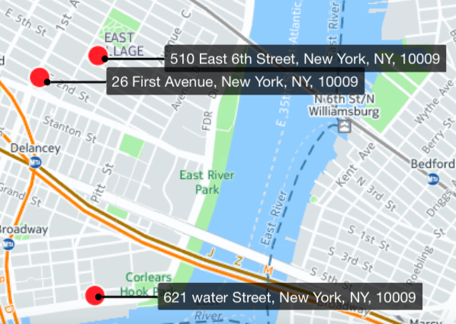
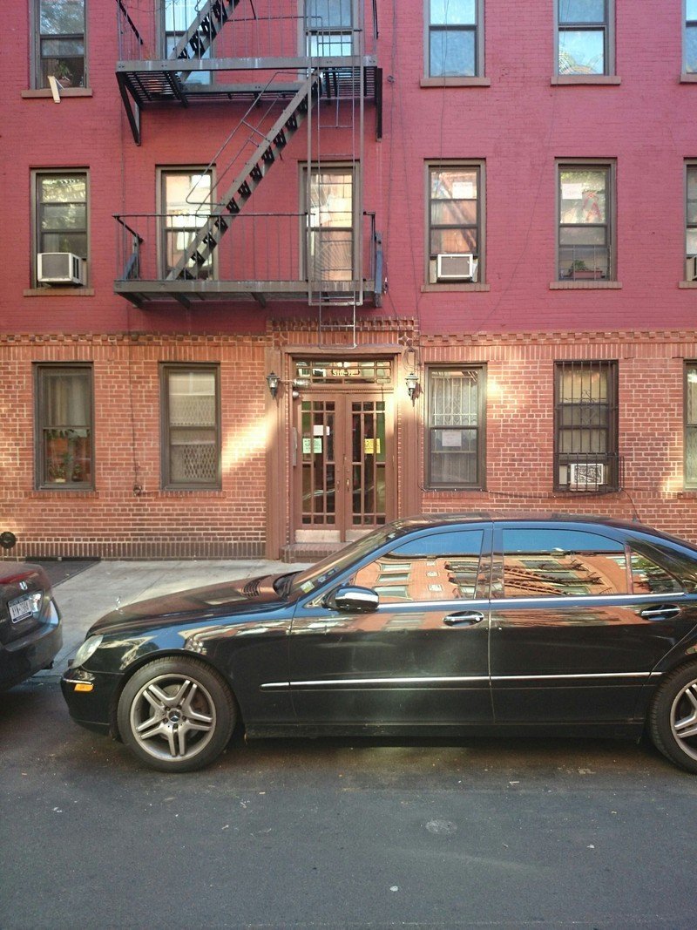
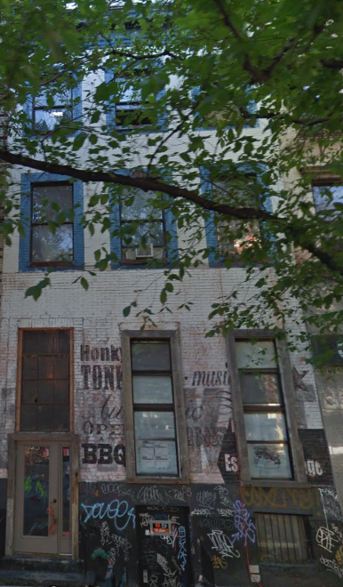
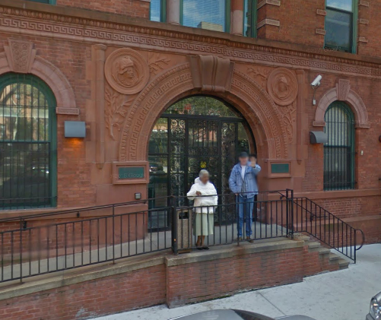
<TOP 3 Repeat caller >
510 E 6th Street(238 complains) 20 Units | 5 Stories | Built in 1900
26 1st Avenue (190complains) 20 Units 6 Stories Built in 1920
621 WATER STREET(156)
124 units 5 stories Built in 1901

Slide 23
Shalom Joseph
227 West 109 ST

Slide 24
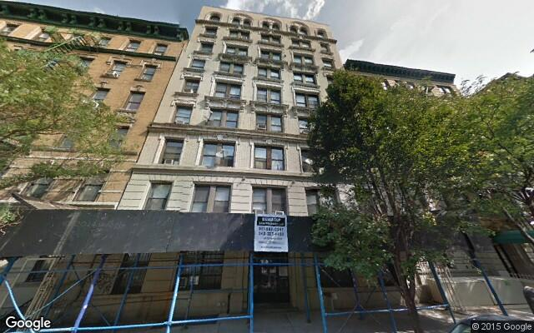
What’s going on here?
Built in 1912
Renovated in 1935
36 units
This building is a hotspot for several 311 requests.
History of structural damage.

Slide 25
Lets look at the data
From May of 2012 - June 2012, heating complaints spiked tremendously.
At the same time there were several complaints against the janitor and the super.
What can we conclude from this?
This could indicate a change in management due to existing problems that were never fixed.
It is also very uncommon for there to be heater problems in the summer.
In June of 2012 there weren’t any complaints against the Janitor or Super.
This can mean that the existing “problem”, whether it was an individual or an object in the building, had been resolved swiftly.

Slide 26
Yes there’s more!
In the same year there were complaints of General Construction, Paint and Plumbing.
Specifically in November and December.
Construction included the tiles. floor and molding.
Paint included the ceiling and walls.
Plumbing included water leaks and basin/sink.
What can be concluded?
All these problems derive off the other.
Problems in construction and paint can lead to plumbing problems and any other combination of the three.
This shows that this building has been through rough changes and that it was, at a point, very unstable.

Slide 27
Conclusion
http://apartable.com/buildings/227-west-109-street-manhattan#building-issues
This link provides all the information about this building and its specifics.
By the end of this year there will be around 280 issues reported to this link alone.
These issues include violations and complaints.

Slide 28
Thierno Bah
Street Conditions &
Potholes

Slide 29
Street condition / pothole
Remarks:
When we analyze the table, we observe that the complaints regarding the cave-in condition go dramatically up during the summer season.

Slide 30
Street condition / pothole
Notes:
top five street condition issues per year:
Cave-In;
Hummock;
Failed Street Repair;
Pothole;
Rough, pitted, or cracked Roads;

Slide 31
Street condition / pothole

Slide 32
Street condition / pothole

Slide 33
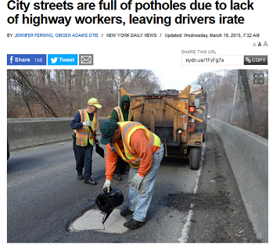

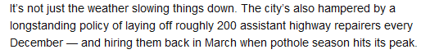
Street condition / pothole

Slide 34
Tammoya Moore
Noise

Slide 35
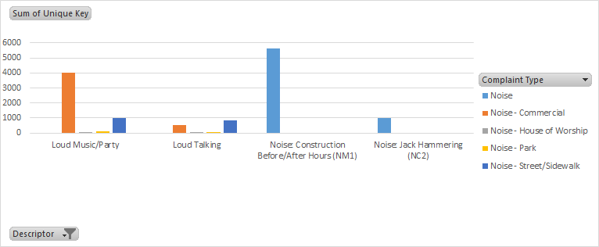
Noise
Top 4 Noise complaints:
Loud Music/ Party - A lot of complaints for commercial noise,house of worship (noise), street/sidewalks (noise).
Loud Talking- commercial noise, street/sidewalks (noise).
Noise Construction - Noise
Noise Jack Hammering- Noise

Slide 36
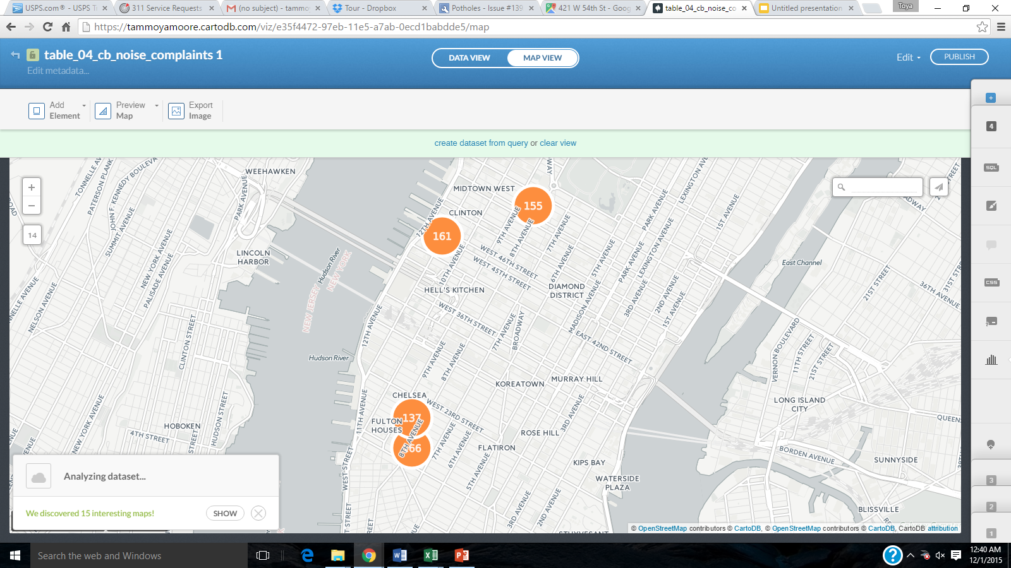
Noise: Hot Spots
Hotspot Locations: h
355 west 16 street (166)
514 west 44 street (161)
939 8 avenue (155)
174 8 avenue (137)
https://tammoyamoore.cartodb.com/viz/e35f4472-97eb- 11e5-a7ab-0ecd1babdde5/map

Slide 37
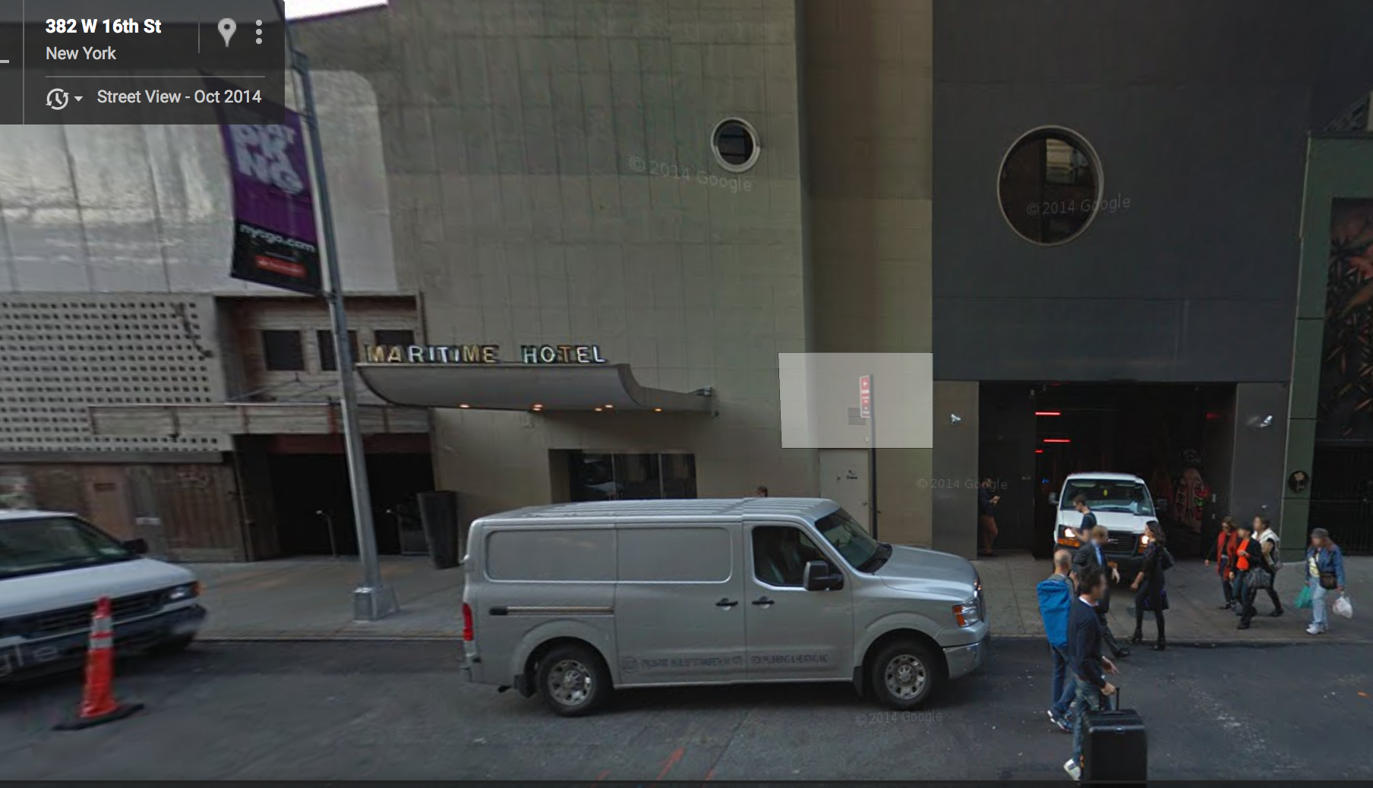
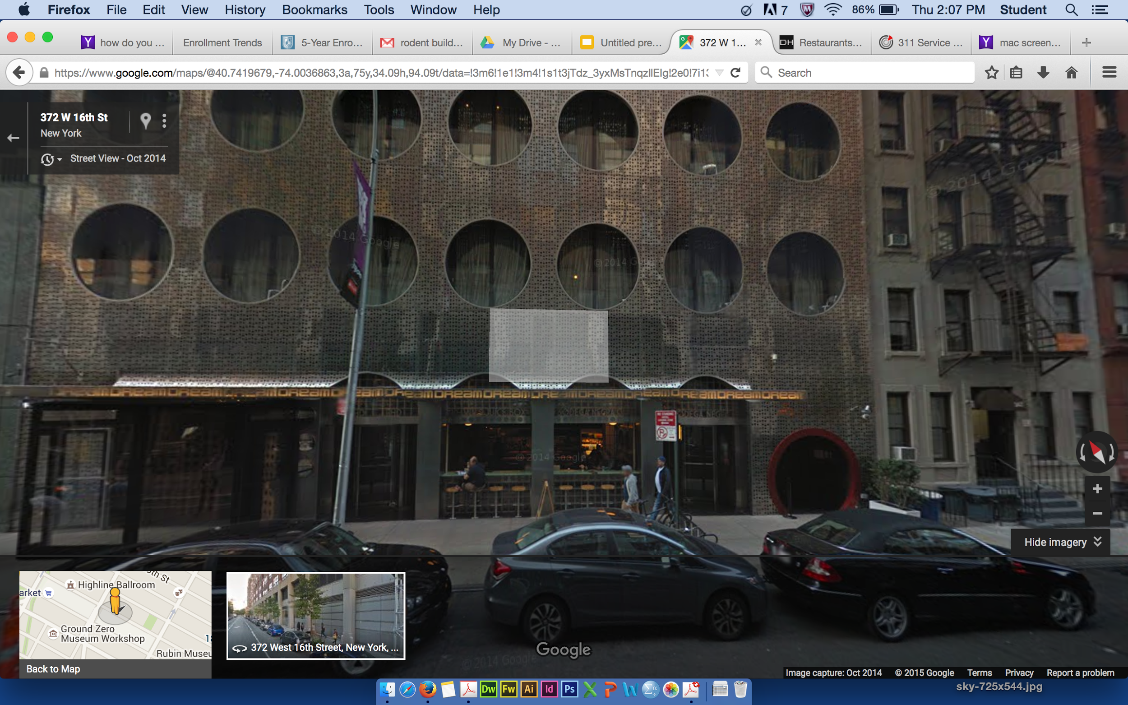
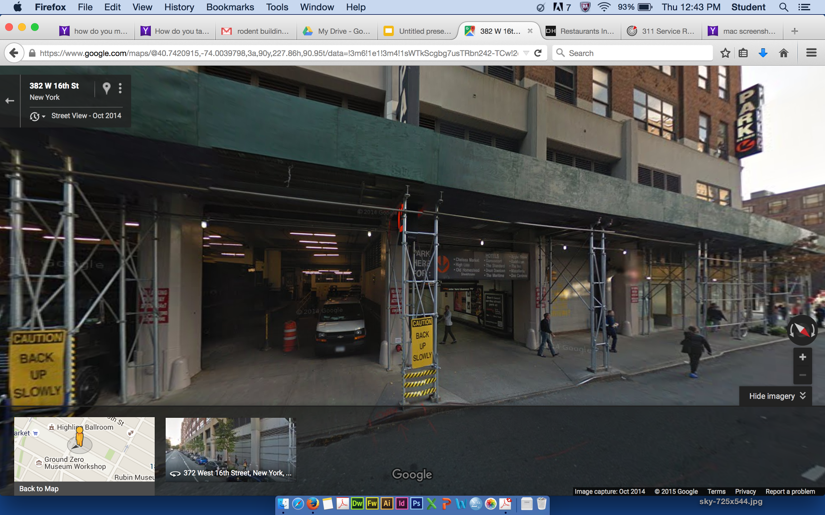
Noise: 355 west 16 street
*In this location there is Maritime hotel and Dream Hotel. Dream hotel is very popular for it’s open bars and clubs (Electric Room)
Complaints: People created noise
Complaints:
Truck Horns, and Truck Music
Complaints:Loud music and parties

Slide 38
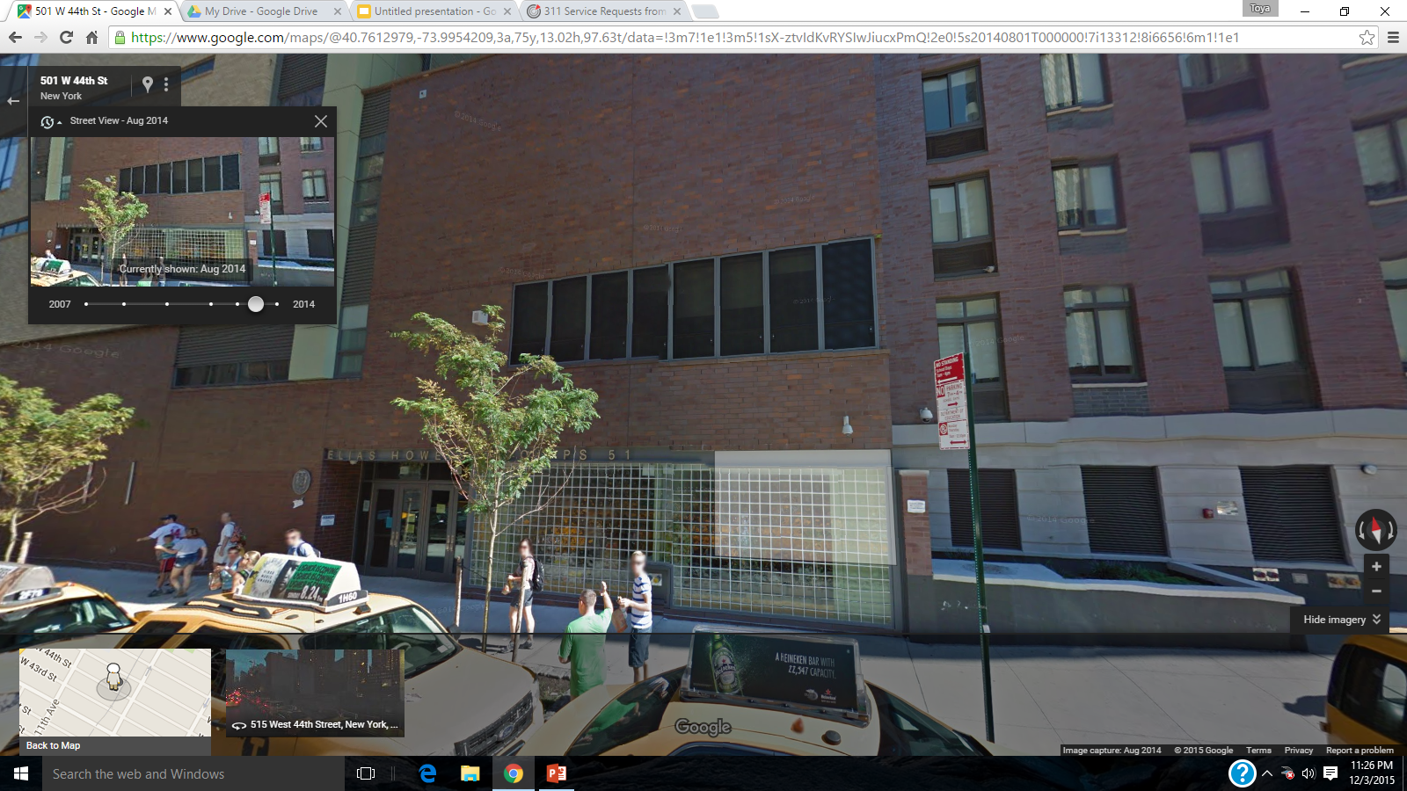
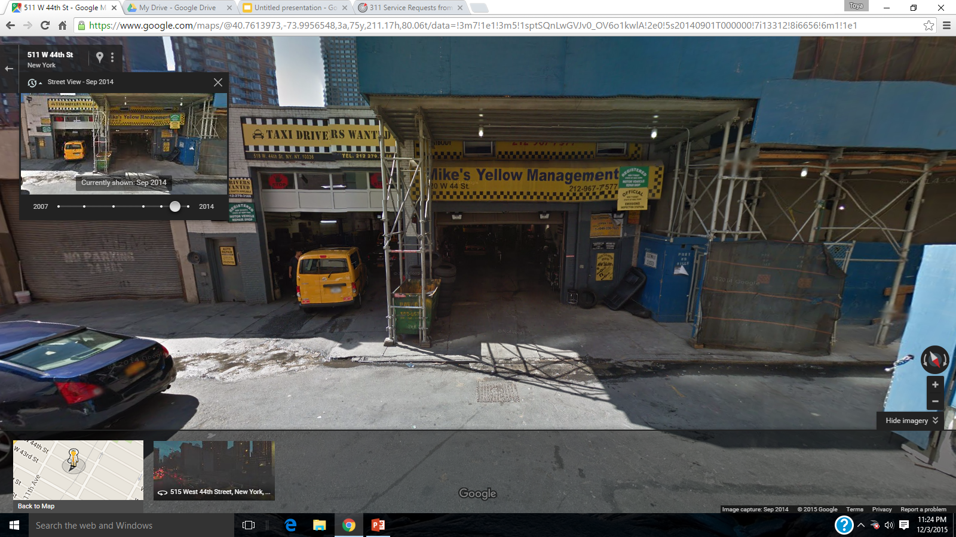
Noise: 514 west 44 street
*Complaints:
-Car/Truck (Horn,Music)
-Loud Music and Loud Talking
-Loud banging noise
School
Taxi station

Slide 39
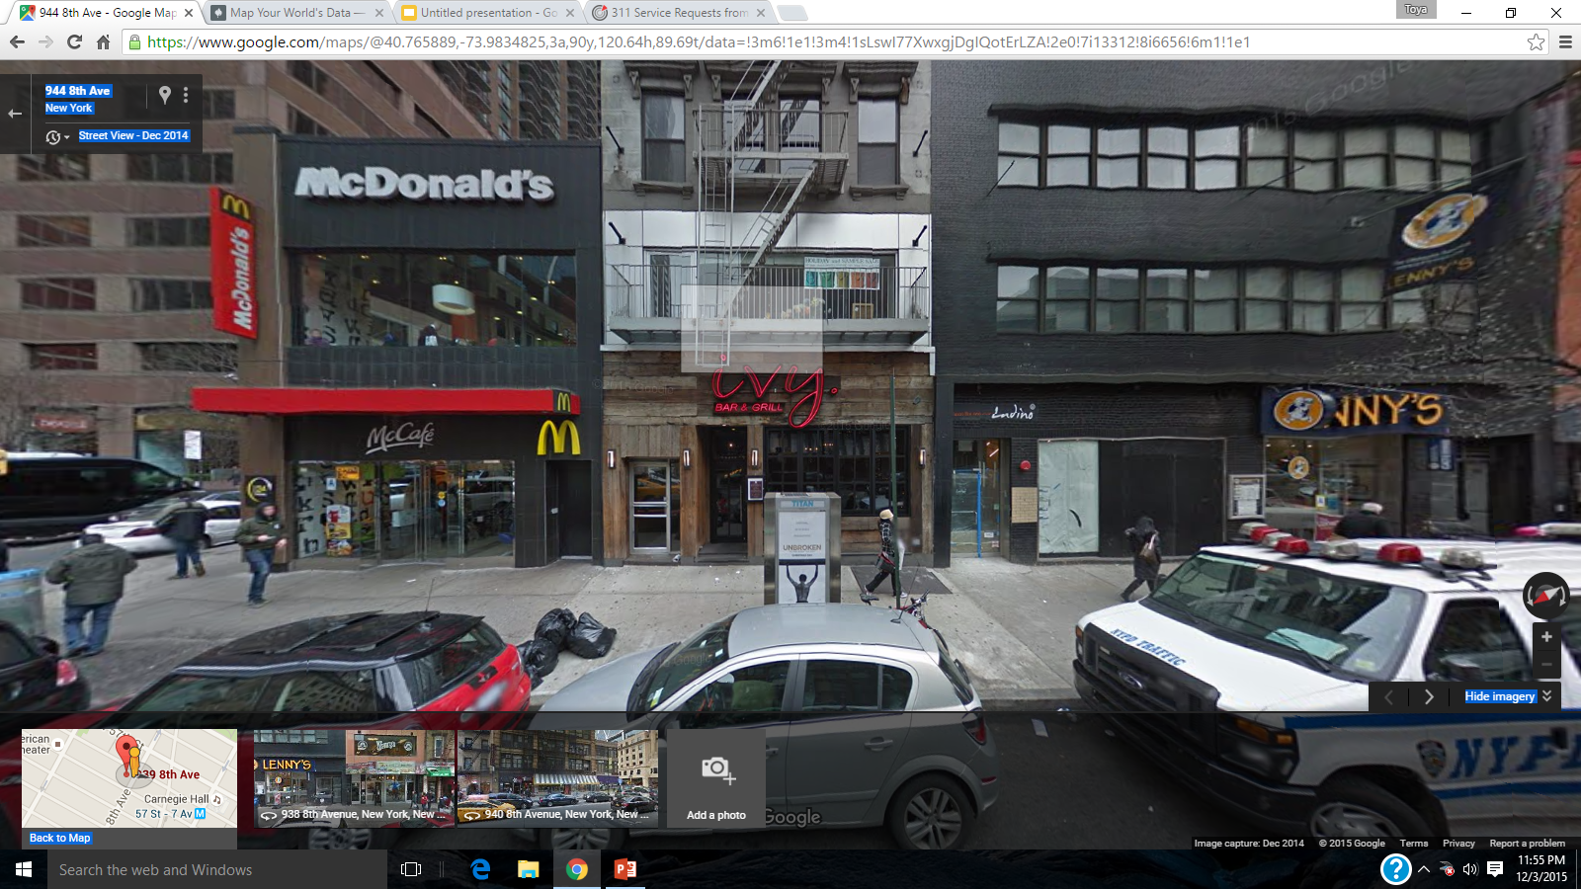
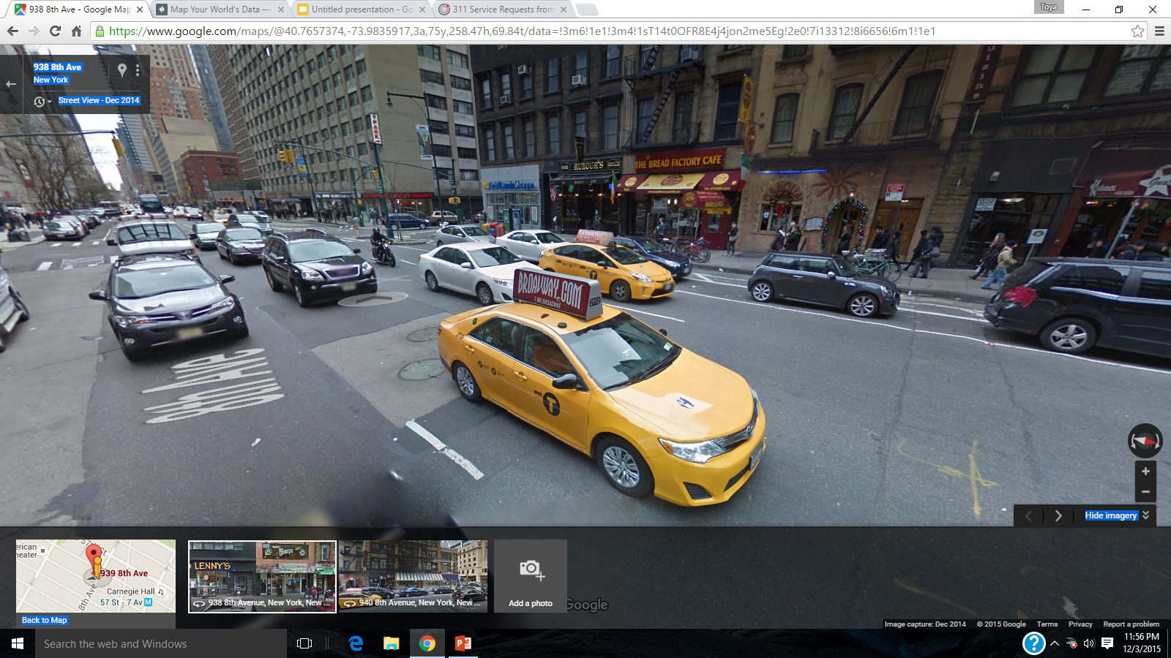
Noise: 939 8 avenue
*Complaints:
- Loud Music and Party
- Car/ truck music
Busy Street
Bars/ fast food spots

